Slide 1

Russell County Industrial Complex
Data Center Sites for Southwest Virginia

Slide 2
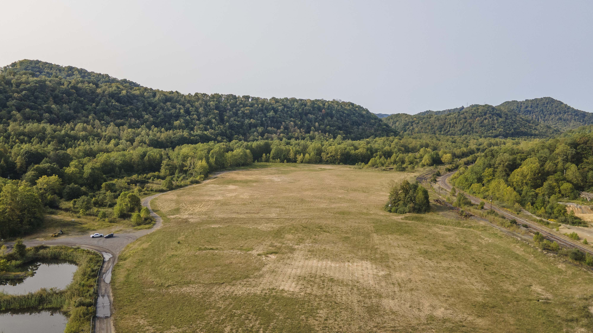
Russell County Industrial Complex

Slide 3
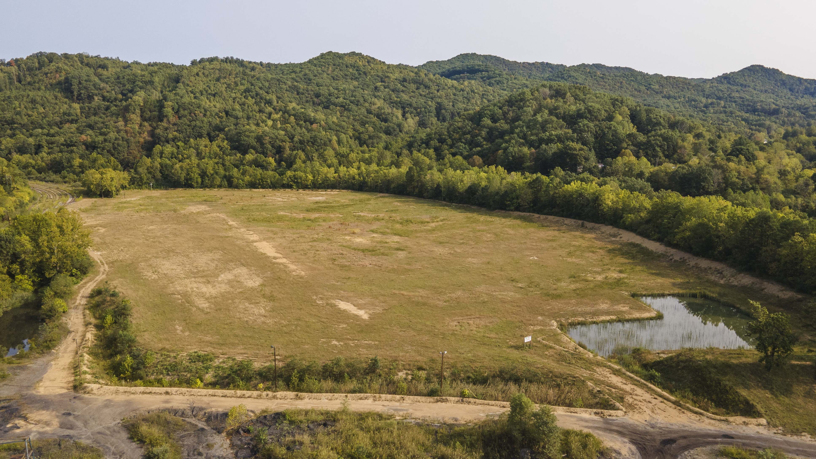
Russell County Industrial Complex

Slide 4
Russell County Industrial Complex Data
234 acre complex
Located off Gravel Lick Road, South Clinchfield VA
GPS Coordinates (Lat/Long) 36.96 N by 82.17 W
Owned by Russell County Industrial Development Authority
Adjacent to 1,200 acre tract of land owned by Russell Reclamation

Slide 5
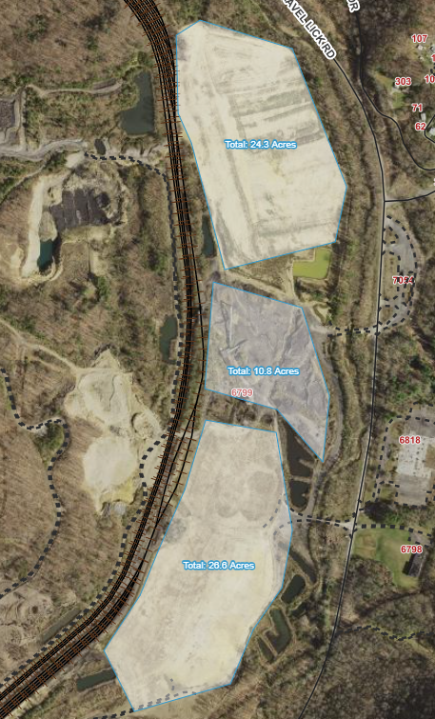
Industrial Complex Pads

Slide 6
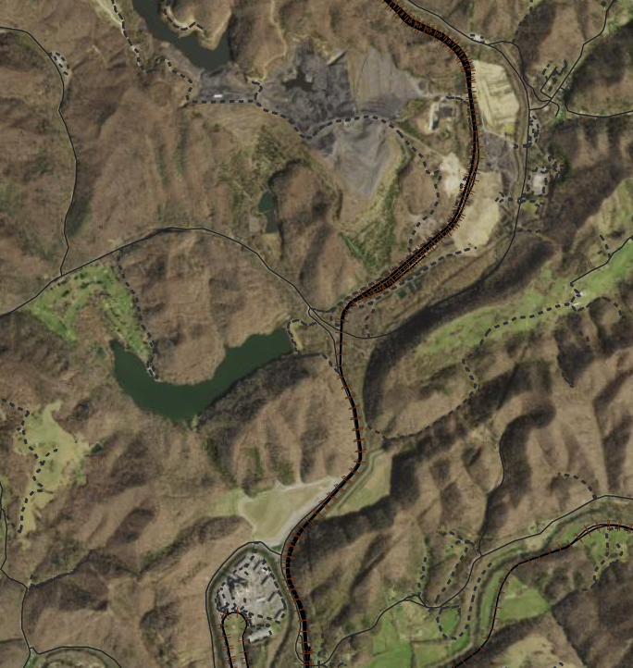
Assets Near the Industrial Complex

Slide 7
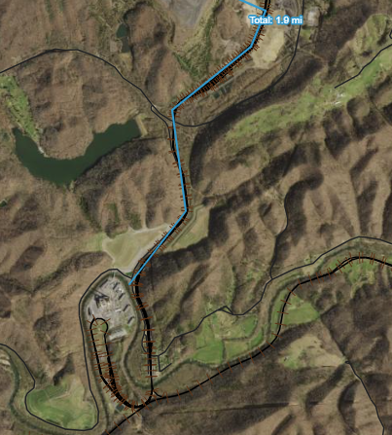
Distance to AEP Carbo Power Plant

Slide 8
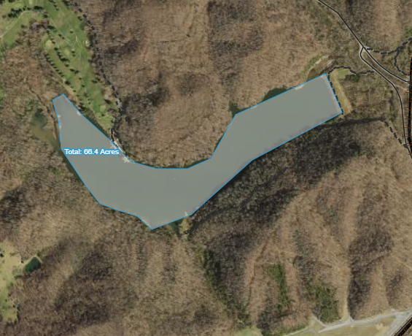
Adjacent water source
Lake Bonaventure
66 Acre lake with over 500
million gallons of water capacity
Pump station already in place
with a 12” supply line feeding
the Industrial Complex
Existing MSHA withdrawal
permit

Slide 9
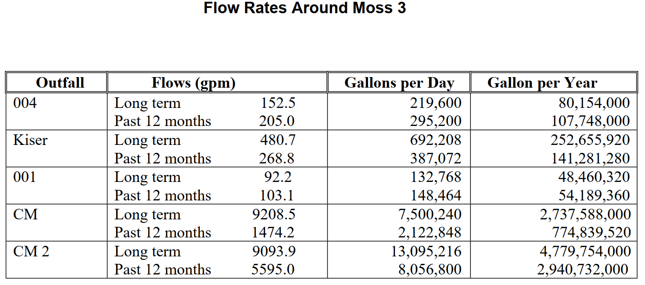
Additional water sources

Slide 10
Public water source
Russell County Public Service Authority
8” water line located on the edge of the property following Gravel Lick Road
Daily capacity of approximately 500,000 gpd

Slide 11
Power Resources 1
AEP Carbo Power Plant
Located 1.9 miles SW of the Industrial Complex
450 MW natural gas power plant
Currently serve the site with an existing 12kV line
Existing 138kV circuit is located 0.5 miles SE of the site
Plant can provide transmission level power, including large power users +50MW

Slide 12
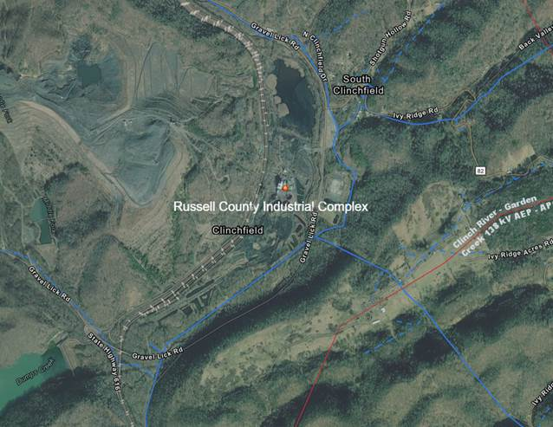
Power Resources 1

Slide 13
Power Resources 2
Dominion Energy VA City Power Plant
Located 9 miles SW of the Industrial Complex
668 MW hybrid power plant
Interconnection located at the Carbo Power Plant
Plant can provide transmission level power, including large power users +50MW

Slide 14
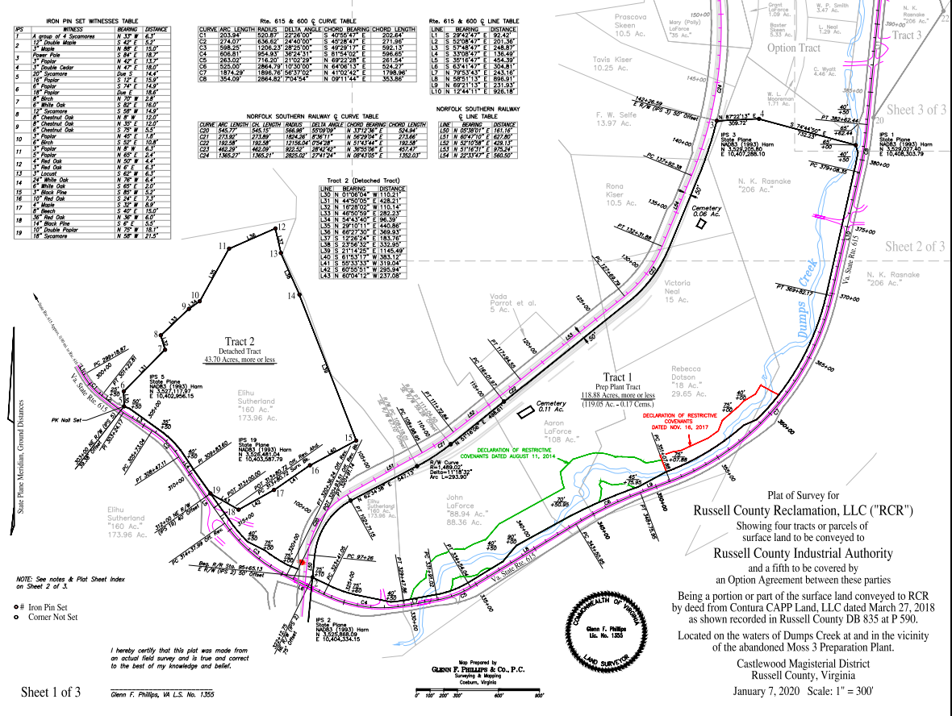
Industrial Complex Plat 1

Slide 15
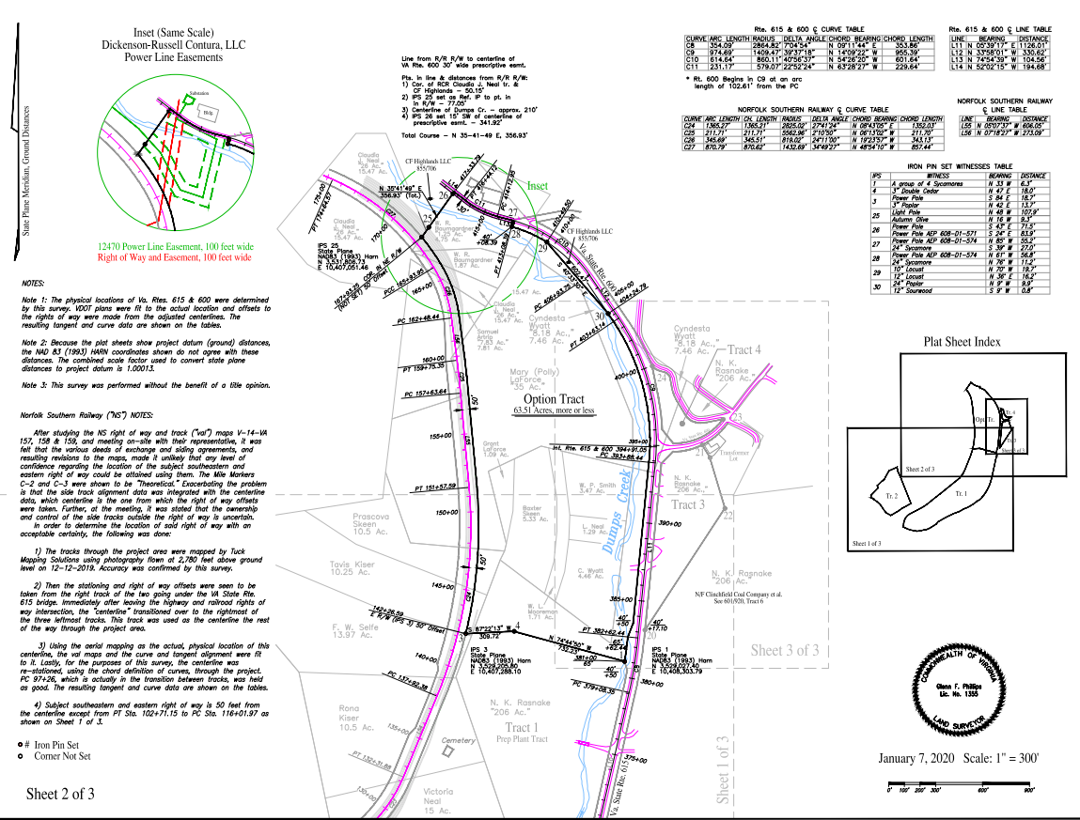
Industrial Complex Plat 2

Slide 16
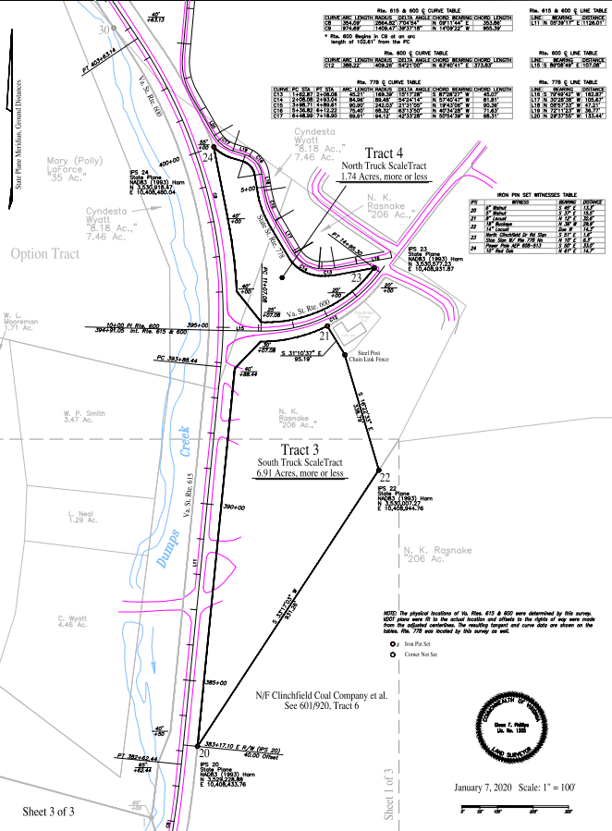
Industrial Complex Plat 3

Slide 17
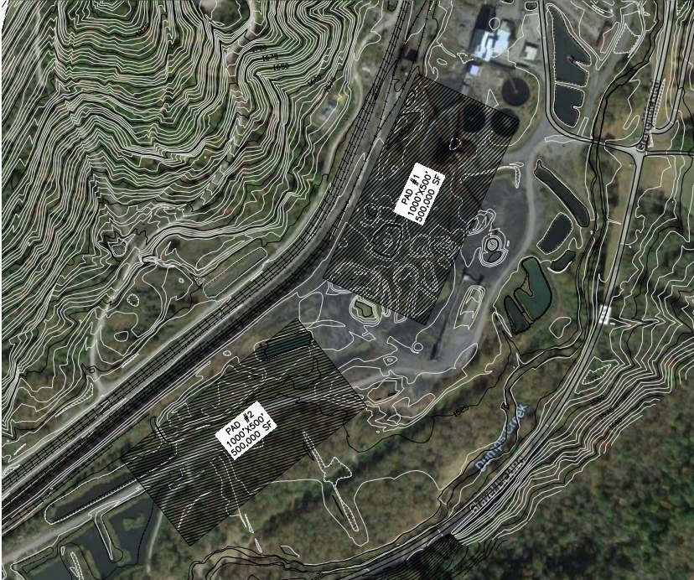
Industrial Complex Concept Layout

Slide 18
Industrial Complex Partners
AML $3,200,000 Reclamation of Golden Pond
Tobacco $2,900,000 Purchase and site development
AML $1,200,000 Construct commercial bridge
VEDP $ 112,750 Due diligence/Tier improvement
Tobacco $ 112,750 Due diligence/Tier improvement
Total property investment to date $7,525,500

Slide 19
A great choice for a Data Center
Adequate acreage for security and seclusion
Short timeline to access over 1 GW of power
Numerous water assets for equipment cooling
On site rail assets for importing building materials and equipment
Attractive tax rates for data center projects
Excellent local and state incentive programs

Slide 20
Partnering for Progress
Ernie McFaddin
Executive Director
ernie@russellcountyida.org
276-971-0690

